Slide 1
Predicting Booking Completion
Model Used: Random Forest with SMOTE

Slide 2
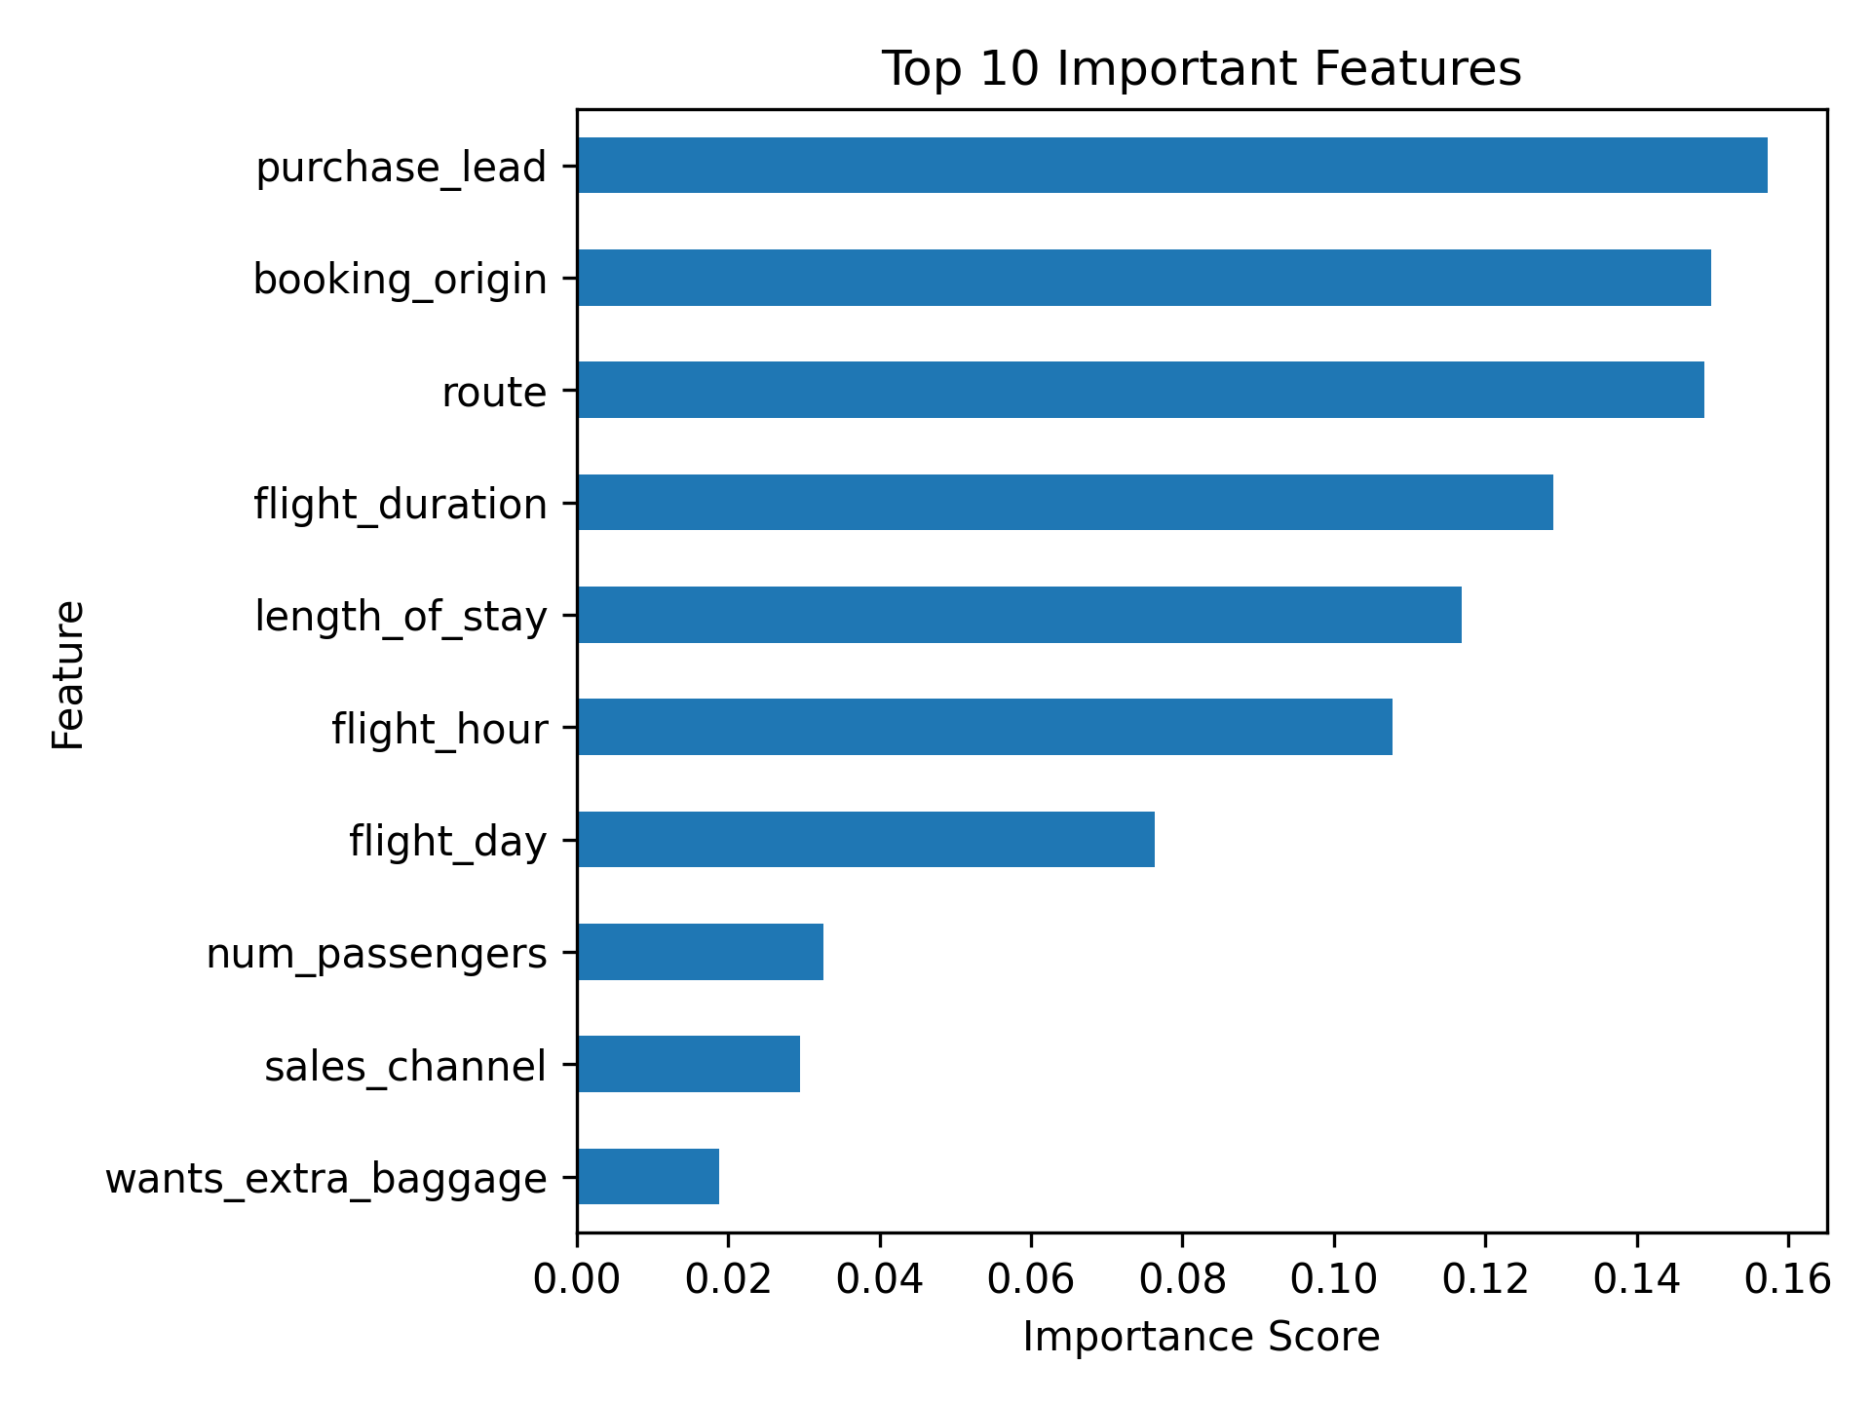
Performance Summary:
Accuracy: 81%
Booking Recall: 37% (↑ from 11% after using SMOTE)
Top Features: e.g., purchase_lead, num_passengers, flight_hour, etc
Recommendation: Use the model to assist sales team in targeting likely bookers.

